Slide 1
L15: Nonisothermal Reactor Example Problems

Slide 2
Review: Multiple Steady States in CSTR
X_{A,MB}
Plot of X_{A,EB} vs T and X_{A,MB} vs T
Intersections are the T and X_{A} that satisfy both mass balance (MB) & energy balance (EB) equations
Each intersection is a steady state (temperature & conversion)
Multiple sets of conditions are possible for the same reaction in the same reactor with the same inlet conditions!

Slide 3
Review: Heat Removal Term R(T) & T₀
Heat removed: R(T)
Heat generated G(T)
R(T) line has slope of C_{P0}(1+κ)
R(T)
κ = ∞
κ = 0
R(T)
Increase κ
Increase T₀
For T_{a} < T₀
T_{a}
T₀
T
When κ increases from lowering F_{A0} or increasing heat exchange, slope and x-intercept moves
T
When T₀ increases, slope stays same & line shifts to right
T_{a}<T₀: x-intercept shifts left as κ↑
T_{a}>T₀: x-intercept shifts right as κ↑
κ=0, then T_{C}=T₀
κ=∞, then T_{C}=T_{a}

Slide 4
Review: CSTR Stability
G(T) > R(T) → T rises to T=SS₃
3
R(T) > G(T) → T falls to T=SS₁
R(T) > G(T)
→T falls to T=SS₃
G(T) > R(T) → T rises to T=SS₁
2
Heat removed: R(T)
Heat generated G(T)
1
Magnitude of G(T) to R(T) curve determines if reactor T will rise or fall
G(T) = R(T) intersection, equal rate of heat generation & removal, no change in T
G(T) > R(T) (G(T) line above R(T) on graph): rate of heat generation > heat removal, so reactor heats up until a steady state is reached
R(T) > G(T) (R(T) line above G(T) on graph): rate of heat generation < heat removal, so reactor cools off until a steady state is reached

Slide 5
The elementary irreversible reaction A + B →C is carried out adiabatically in a flow reactor with Ẇ_{S}=0. An equal molar feed of A & B enters at 300K with υ₀ = 2 dm³/s and C_{A0} = 0.1 mol/dm³. What is the PFR & CSTR volume required to achieve X_{A}=0.85?
Extra info: liquid phase rxn C_{pA}=C_{pB}=15 cal/mol•K C_{pC}= 30 cal/mol E = 10,000 cal/mol
ΔH_{A}°(273K)= -20 kcal/mol ΔH_{B}°(273K)= -15 kcal/mol ΔH_{C}°(273K)= -41 kcal/mol
Strategy:
Mole balance
Rate Law
Stoichiometry
Combine rate law & stoichiometry
Energy balance
Solve
6a. Solve CSTR
Use EB to find T as a function of X_{A}
Calculate V using the CSTR design eq with k calculated at that T
6b. Solve PFR
Use EB to construct table of T as a function of X_{A}
Use k = Ae^{-E/RT} to construct table of k as function of T & therefore X_{A}
Calculate -r_{A} as a function of T & X_{A}
Calculate F_{A0}/-r_{A} for each T
Use numeric technique to calculate V

Slide 6
The elementary irreversible reaction A + B →C is carried out adiabatically in a flow reactor with Ẇ_{S}=0. An equal molar feed of A & B enters at 300K with υ₀ = 2 dm³/s and C_{A0} = 0.1 mol/dm³. What is the PFR & CSTR volume required to achieve X_{A}=0.85?
Extra info: C_{pA}=C_{pB}=15 cal/mol•K C_{pC}= 30 cal/mol E = 10,000 cal/mol
ΔH_{A}°(273K)= -20 kcal/mol ΔH_{B}°(273K)= -15 kcal/mol ΔH_{C}°(273K)= -41 kcal/mol
CSTR
PFR
Mole balance
Rate law
Stoichiometry
Combine:

Slide 7
The elementary irreversible reaction A + B →C is carried out adiabatically in a flow reactor with Ẇ_{S}=0. An equal molar feed of A & B enters at 300K with υ₀ = 2 dm³/s and C_{A0} = 0.1 mol/dm³. What is the PFR & CSTR volume required to achieve X_{A}=0.85?
Extra info: C_{pA}=C_{pB}=15 cal/mol•K C_{pC}= 30 cal/mol E = 10,000 cal/mol
ΔH_{A}°(273K)= -20 kcal/mol ΔH_{B}°(273K)= -15 kcal/mol ΔH_{C}°(273K)= -41 kcal/mol
Combine MB, rate law & stoichiometry for CSTR:
CSTR

Slide 8
The elementary irreversible reaction A + B →C is carried out adiabatically in a flow reactor with Ẇ_{S}=0. An equal molar feed of A & B enters at 300K with υ₀ = 2 dm³/s and C_{A0} = 0.1 mol/dm³. What is the PFR & CSTR volume required to achieve X_{A}=0.85?
Extra info: C_{pA}=C_{pB}=15 cal/mol•K C_{pC}= 30 cal/mol E = 10,000 cal/mol
ΔH_{A}°(273K)= -20 kcal/mol ΔH_{B}°(273K)= -15 kcal/mol ΔH_{C}°(273K)= -41 kcal/mol
Energy balance
Solve for T:
0
0
Substitute:
Multiply out quantities in brackets, bring T to 1 side of equation, factor out T, divide by quantity in bracket:
Evaluate ΔC_{p}:

Slide 9
The elementary irreversible reaction A + B →C is carried out adiabatically in a flow reactor with Ẇ_{S}=0. An equal molar feed of A & B enters at 300K with υ₀ = 2 dm³/s and C_{A0} = 0.1 mol/dm³. What is the PFR & CSTR volume required to achieve X_{A}=0.85?
Extra info: C_{pA}=C_{pB}=15 cal/mol•K C_{pC}= 30 cal/mol E = 10,000 cal/mol
ΔH_{A}°(273K)= -20 kcal/mol ΔH_{B}°(273K)= -15 kcal/mol ΔH_{C}°(273K)= -41 kcal/mol
Energy balance
Evaluate ΣΘ_{i}C_{p}:
Evaluate ΔH°_{RX}(T_{R}):
Simplify EB:

Slide 10
The elementary irreversible reaction A + B →C is carried out adiabatically in a flow reactor with Ẇ_{S}=0. An equal molar feed of A & B enters at 300K with υ₀ = 2 dm³/s and C_{A0} = 0.1 mol/dm³. What is the PFR & CSTR volume required to achieve X_{A}=0.85?
Extra info: C_{pA}=C_{pB}=15 cal/mol•K C_{pC}= 30 cal/mol E = 10,000 cal/mol
ΔH_{A}°(273K)= -20 kcal/mol ΔH_{B}°(273K)= -15 kcal/mol ΔH_{C}°(273K)= -41 kcal/mol
Solve for CSTR volume: use EB to find T when X_{A}=0.85

Slide 11
The elementary irreversible reaction A + B →C is carried out adiabatically in a flow reactor with Ẇ_{S}=0. An equal molar feed of A & B enters at 300K with υ₀ = 2 dm³/s and C_{A0} = 0.1 mol/dm³. What is the PFR & CSTR volume required to achieve X_{A}=0.85?
Solve for PFR:
Use EB to construct table of T as a function of X_{A} (We’re interested in range where X_{A} = 0 to X_{A} = 0.85)
X_{A} | T (K) | k (dm³/mol·s) | -r_{A} (mol/dm³·s) | F_{A0}/-r_{A} (dm³)
0
0.2
0.4
0.6
0.8
0.85
300

Slide 12
The elementary irreversible reaction A + B →C is carried out adiabatically in a flow reactor with Ẇ_{S}=0. An equal molar feed of A & B enters at 300K with υ₀ 2 dm³/s and C_{A0} = 0.1 mol/dm³. What is the PFR & CSTR volume required to achieve X_{A}=0.85?
Solve for PFR:
Use EB to construct table of T as a function of X_{A} -Temperature range should cover X_{A} = 0 to X_{A} = 0.85
X_{A} | T (K) | k (dm³/mol·s) | -r_{A} (mol/dm³·s) | F_{A0}/-r_{A} (dm³)
0 | 300
0.2 | 340
0.4 | 380
0.6 | 420
0.8 | 460
0.85 | 470
Calculate k(T) for each T in the table

Slide 13
The elementary irreversible reaction A + B →C is carried out adiabatically in a flow reactor with Ẇ_{S}=0. An equal molar feed of A & B enters at 300K with υ₀ = 2 dm³/s and C_{A0} = 0.1 mol/dm³. What is the PFR & CSTR volume required to achieve X_{A}=0.85?
Solve for PFR:
Use EB to construct table of T as a function of X_{A} -Temperature range should cover X_{A} = 0 to X_{A} = 0.85
X_{A} | T (K) | k (dm³/mol·s) | -r_{A} (mol/dm³·s) | F_{A0}/-r_{A} (dm³)
0 | 300 | 0.01
0.2 | 340 | 0.072
0.4 | 380 | 0.34
0.6 | 420 | 1.21
0.8 | 460 | 3.42
0.85 | 470 | 4.31
Calculate k(T) for each T in the table

Slide 14
The elementary irreversible reaction A + B →C is carried out adiabatically in a flow reactor with Ẇ_{S}=0. An equal molar feed of A & B enters at 300K with υ₀ = 2 dm³/s and C_{A0} = 0.1 mol/dm³. What is the PFR & CSTR volume required to achieve X_{A}=0.85?
Solve for PFR:
Use EB to construct table of T as a function of X_{A} -Temperature range should cover X_{A} = 0 to X_{A} = 0.85
Calculate k(T)
X_{A} | T (K) | k (dm³/mol·s) | -r_{A} (mol/dm³·s) | F_{A0}/-r_{A} (dm³)
0 | 300 | 0.01
0.2 | 340 | 0.072
0.4 | 380 | 0.34
0.6 | 420 | 1.21
0.8 | 460 | 3.42
0.85 | 470 | 4.31
Calculate –r_{A} each X_{A} and k in the table

Slide 15
The elementary irreversible reaction A + B →C is carried out adiabatically in a flow reactor with Ẇ_{S}=0. An equal molar feed of A & B enters at 300K with υ₀ = 2 dm³/s and C_{A0} = 0.1 mol/dm³. What is the PFR & CSTR volume required to achieve X_{A}=0.85?
Solve for PFR:
Use EB to construct table of T as a function of X_{A} -Temperature range should cover X_{A} = 0 to X_{A} = 0.85
Calculate k(T)
X_{A} | T (K) | k (dm³/mol·s) | -r_{A} (mol/dm³·s) | F_{A0}/-r_{A} (dm³)
0 | 300 | 0.01 | 0.0001
0.2 | 340 | 0.072 | 0.00046
0.4 | 380 | 0.34 | 0.00122
0.6 | 420 | 1.21 | 0.00194
0.8 | 460 | 3.42 | 0.0014
0.85 | 470 | 4.31 | 0.00097
Calculate –r_{A} each X_{A} and k in the table

Slide 16
The elementary irreversible reaction A + B →C is carried out adiabatically in a flow reactor with Ẇ_{S}=0. An equal molar feed of A & B enters at 300K with υ₀ 2 dm³/s and C_{A0} = 0.1 mol/dm³. What is the PFR & CSTR volume required to achieve X_{A}=0.85?
Solve for PFR:
Use EB to construct table of T as a function of X_{A} -Temperature range should cover X_{A} = 0 to X_{A} = 0.85
Calculate k(T)
Calculate –r_{A} each X_{A} and k in the table
X_{A} | T (K) | k (dm³/mol·s) | -r_{A} (mol/dm³·s) | F_{A0}/-r_{A} (dm³)
0 | 300 | 0.01 | 0.0001
0.2 | 340 | 0.072 | 0.00046
0.4 | 380 | 0.34 | 0.00122
0.6 | 420 | 1.21 | 0.00194
0.8 | 460 | 3.42 | 0.0014
0.85 | 470 | 4.31 | 0.00097
Calculate F_{A0}/–r_{A} for each X_{A} in the table

Slide 17
The elementary irreversible reaction A + B →C is carried out adiabatically in a flow reactor with Ẇ_{S}=0. An equal molar feed of A & B enters at 300K with υ₀ = 2 dm³/s and C_{A0} = 0.1 mol/dm³. What is the PFR & CSTR volume required to achieve X_{A}=0.85?
Solve for PFR:
Use EB to construct table of T as a function of X_{A} -Temperature range should cover X_{A} = 0 to X_{A} = 0.85
Calculate k(T)
Calculate –r_{A} each X_{A} and k in the table
X_{A} | T (K) | k (dm³/mol·s) | -r_{A} (mol/dm³·s) | F_{A0}/-r_{A} (dm³)
0 | 300 | 0.01 | 0.0001 | 2000
0.2 | 340 | 0.072 | 0.00046 | 434.8
0.4 | 380 | 0.34 | 0.00122 | 163.9
0.6 | 420 | 1.21 | 0.00194 | 103.1
0.8 | 460 | 3.42 | 0.0014 | 142.9
0.85 | 470 | 4.31 | 0.00097 | 206.2
Calculate F_{A0}/–r_{A} for each X_{A} in the table

Slide 18
The elementary irreversible reaction A + B →C is carried out adiabatically in a flow reactor with Ẇ_{S}=0. An equal molar feed of A & B enters at 300K with υ₀ = 2 dm³/s and C_{A0} = 0.1 mol/dm³. What is the PFR & CSTR volume required to achieve X_{A}=0.85?
Solve for PFR:
X_{A} | T (K) | k (dm³/mol·s) | -r_{A} (mol/dm³·s) | F_{A0}/-r_{A} (dm³)
0 | 300 | 0.01 | 0.0001 | 2000
0.2 | 340 | 0.072 | 0.00046 | 434.8
0.4 | 380 | 0.34 | 0.00122 | 163.9
0.6 | 420 | 1.21 | 0.00194 | 103.1
0.8 | 460 | 3.42 | 0.00137 | 146
0.85 | 470 | 4.31 | 0.00097 | 206.2
Numeric evaluation by parts: 5-point rule for X_{A} interval 0 to 0.8, 2-point rule for X_{A} interval from 0.8 to 0.85:

Slide 19
For these conditions, what is the max T₀ that would keep T≤ 550K at complete conversion?
T≤ 550K at complete conversion, X_{A}=1:
Max T₀ is 350K

Slide 20
The first order irreversible reaction A(l) → B(l) is carried out in a jacketed CSTR. The feed contains A and an inert liquid in equimolar amounts, where F_{A0} = 80 mol/min. What is the reactor temp when the inlet temp T₀ is 450K?
UA= 8000 cal/min·K T_{a}= 300K ΔH_{RX}=-7500 cal/mol C_{pA} = C_{pB} =20 cal/mol·K
C_{pi} =30 cal/mol·K τ=100 min E=40,000 cal/mol k=6.6 x 10⁻³ min⁻¹ at 350K
Need to find where G(T)=R(T) for T₀ = 450K
Put R(T) & G(T) in terms of constants in the problem statement
Plot R(T) vs T and G(T) vs T on the same graph & find where they intersect

Slide 21
The first order irreversible reaction A(l) → B(l) is carried out in a jacketed CSTR. The feed contains A and an inert liquid in equimolar amounts, where F_{A0} = 80 mol/min. What is the reactor temp when the inlet temp T₀ is 450K?
UA= 8000 cal/min·K T_{a}= 300K ΔH_{RX}=-7500 cal/mol C_{pA} = C_{pB} =20 cal/mol·K
C_{pi} =30 cal/mol·K τ=100 min E=40,000 cal/mol k=6.6 x 10⁻³ min⁻¹ at 350K
I = inert
Put R(T) in terms of constants in the problem statement, starting with C_{P0}:
Put κ in terms of constants from the problem statement:
Put T_{C} in terms of constants in the problem statement:

Slide 22
The first order irreversible reaction A(l) → B(l) is carried out in a jacketed CSTR. The feed contains A and an inert liquid in equimolar amounts, where F_{A0} = 80 mol/min. What is the reactor temp when the inlet temp T₀ is 450K?
UA= 8000 cal/min·K T_{a}= 300K ΔH_{RX}=-7500 cal/mol C_{pA} = C_{pB} =20 cal/mol·K
C_{pi} =30 cal/mol·K τ=100 min E=40,000 cal/mol k=6.6 x 10⁻³ min⁻¹ at 350K
I = inert
Find steady state temp [G(T)=R(T) ] for T₀ = 450K
Plug κ and T_{c} into R(T):

Slide 23
The first order irreversible reaction A(l) → B(l) is carried out in a jacketed CSTR. The feed contains A and an inert liquid in equimolar amounts, where F_{A0} = 80 mol/min. What is the reactor temp when the inlet temp T₀ is 450K?
UA= 8000 cal/min·K T_{a}= 300K ΔH_{RX}=-7500 cal/mol C_{pA} = C_{pB} =20 cal/mol·K
C_{pi} =30 cal/mol·K τ=100 min E=40,000 cal/mol k=6.6 x 10⁻³ min⁻¹ at 350K
I = inert
Find steady state temp [G(T)=R(T) ] for T₀ = 450K
Now put G(T) in terms of constants from the problem statement:
Rate law:
Stoichiometry:
Combine:

Slide 24
The first order irreversible reaction A(l) → B(l) is carried out in a jacketed CSTR. The feed contains A and an inert liquid in equimolar amounts, where F_{A0} = 80 mol/min. What is the reactor temp when the inlet temp T₀ is 450K?
UA= 8000 cal/min·K T_{a}= 300K ΔH_{RX}=-7500 cal/mol C_{pA} = C_{pB} =20 cal/mol·K
C_{pi} =30 cal/mol·K τ=100 min E=40,000 cal/mol k=6.6 x 10⁻³ min⁻¹ at 350K
I = inert
Find steady state temp [G(T)=R(T) ] for T₀ = 450K
Plug rate law into G(T) & simplify:

Slide 25
The first order irreversible reaction A(l) → B(l) is carried out in a jacketed CSTR. The feed contains A and an inert liquid in equimolar amounts, where F_{A0} = 80 mol/min. What is the reactor temp when the inlet temp T₀ is 450K?
UA= 8000 cal/min·K T_{a}= 300K ΔH_{RX}=-7500 cal/mol C_{pA} = C_{pB} =20 cal/mol·K
C_{pi} =30 cal/mol·K τ=100 min E=40,000 cal/mol k=6.6 x 10⁻³ min⁻¹ at 350K
I = inert
Steady state temp [G(T)=R(T) ] for T₀ = 450K
Rearrange so can be solved with Polymath nonlinear equation solver:
Use design equation to get X_{A} as an explicit equation:
Explicit equation for Polymath

Slide 26
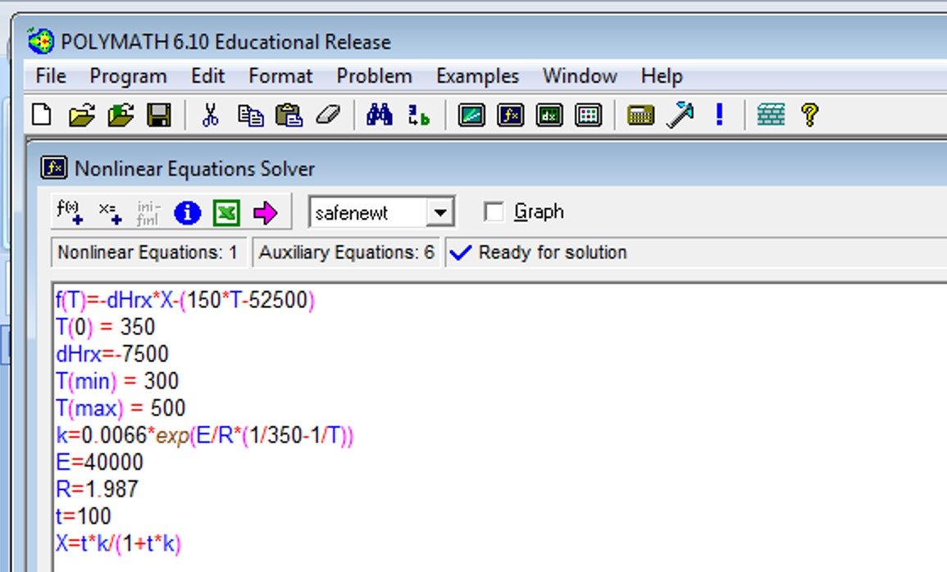
Enter in Polymath:
Select graph
If you want to see this graphically, click the Graph button above
Calculated values of NLE variables
 | Variable | Value | f(x) | Initial Guess
1 | T | 399.9425 | -4.547E-12 | 400. ( 300. < T < 500. )

Slide 27
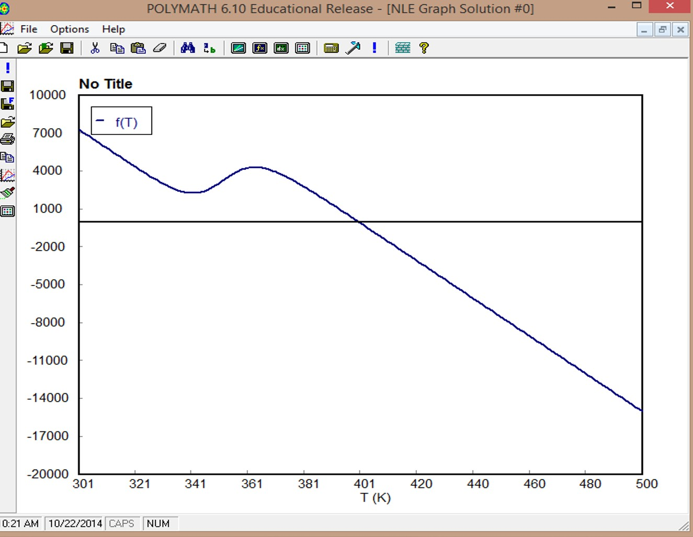
Format the graph
Create a table, save it as a text file, import into Excel, & make a graph with correct labels

Slide 28
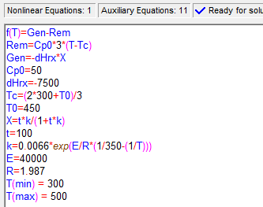
Plot reactor temperature as a function of feed temperature, with T₀ between 350 and 450K
Need to re-run the Polymath program using various T₀ between 350 and 450K to find the new steady state reactor temperatures
Do we need to change G(T) or R(T) when T₀ changes?
G(T) does not depend on T₀
C_{P0} and κ do not depend on T₀, but T_{C} does
Enter equations into Polymath so that R(T) varies according to T₀, & run program with varied values of T₀
Run over and over again, varying T₀ from 350 K to 450 K
In Excel, create a table of T vs T₀, and make a graph

Slide 29
Steady state temperature as a function of T₀
T₀ (K) | T₁ (K) | T₂ (K) | T₃ (K)
350 | 316.7
360 | 320.15
370 | 323.6 | 357.16 | 370.3
380 | 327.3 | 353.4 | 375.1
390 | 331.2 | 350.1 | 379.1
400 | 336.3 | 346 | 382.8
410 | 386
420 | 389.8
430 | 393.2
440 | 396.6
450 | 399.9

Slide 30
The elementary, irreversible reaction A(l) → B(l) is carried out in a jacketed CSTR. The feed contains pure A, & it enters the reactor at 310 K, where F_{A0} = 60 mol/min and υ₀ = 300 L/min. Extra info: UA= 3200 cal/min•K T_{a}= 340 K ∆H_{RX}(T_{R}) = -10,000 cal/mol C_{pA}=15 cal/mol·K C_{pB}=15 cal/mol·K τ =120 min E =20,000 cal/mol k(400K) = 1 min⁻¹
What is the value of the heat generated term (with units) when a disturbance causes the temperature in the reactor to drift to 360 K if –r_{A} = 0.0015 mol/L•min at 360K? (The reactor is NOT at the steady state.)

Slide 31
The elementary, irreversible reaction A(l) → B(l) is carried out in a jacketed CSTR. The feed contains pure A, & it enters the reactor at 310 K, where F_{A0} = 60 mol/min and υ₀ = 300 L/min. Extra info: UA= 3200 cal/min•K T_{a}= 340 K ∆H_{RX}(T_{R}) = -10,000 cal/mol C_{pA}=15 cal/mol·K C_{pB}=15 cal/mol·K τ =120 min E =20,000 cal/mol k(400K) = 1 min⁻¹
What is the value of the heat generated term (with units) when a disturbance causes the temperature in the reactor to drift to 360 K if –r_{A} = 0.0015 mol/L•min at 360K? (The reactor is NOT at the steady state.)

Slide 32
The elementary, irreversible reaction A(l) → B(l) is carried out in a jacketed CSTR. The feed contains pure A, & it enters the reactor at 310 K, where F_{A0} = 60 mol/min and υ₀ = 300 L/min. Extra info: UA= 3200 cal/min•K T_{a}= 340 K ∆H_{RX}(T_{R}) = -10,000 cal/mol C_{pA}=15 cal/mol·K C_{pB}=15 cal/mol·K τ =120 min E =20,000 cal/mol k(400K) = 1 min⁻¹
What is the value of the heat generated term (with units) when a disturbance causes the temperature in the reactor to drift to 360 K if –r_{A} = 0.0015 mol/L•min at 360K? (The reactor is NOT at the steady state.)

Slide 33
The elementary, irreversible reaction A(l) → B(l) is carried out in a jacketed CSTR. The feed contains pure A, & it enters the reactor at 310 K, where F_{A0} = 60 mol/min and υ₀ = 300 L/min. Extra info: UA= 3200 cal/min•K T_{a}= 340 K ∆H_{RX}(T_{R}) = -10,000 cal/mol C_{pA}=15 cal/mol·K C_{pB}=15 cal/mol·K τ =120 min E =20,000 cal/mol k(400K) = 1 min⁻¹
What is the value of the heat removal term (with units) when a disturbance causes the temperature in the reactor to drift to 360 K if –r_{A} = 0.0015 mol/L•min at 360K? (The reactor is NOT at the steady state.)

Slide 34
The elementary, irreversible reaction A(l) → B(l) is carried out in a jacketed CSTR. The feed contains pure A, & it enters the reactor at 310 K, where F_{A0} = 60 mol/min and υ₀ = 300 L/min. Extra info: UA= 3200 cal/min•K T_{a}= 340 K ∆H_{RX}(T_{R}) = -10,000 cal/mol C_{pA}=15 cal/mol·K C_{pB}=15 cal/mol·K τ =120 min E =20,000 cal/mol k(400K) = 1 min⁻¹
What is the value of the heat removal term (with units) when a disturbance causes the temperature in the reactor to drift to 360 K if –r_{A} = 0.0015 mol/L•min at 360K? (The reactor is NOT at the steady state.)

Slide 35
The elementary, irreversible reaction A(l) → B(l) is carried out in a jacketed CSTR. The feed contains pure A, & it enters the reactor at 310 K, where F_{A0} = 60 mol/min and υ₀ = 300 L/min. Extra info: UA= 3200 cal/min•K T_{a}= 340 K ∆H_{RX}(T_{R}) = -10,000 cal/mol C_{pA}=15 cal/mol·K C_{pB}=15 cal/mol·K τ =120 min E =20,000 cal/mol k(400K) = 1 min⁻¹
What is the value of the heat removal term (with units) when a disturbance causes the temperature in the reactor to drift to 360 K if –r_{A} = 0.0015 mol/L•min at 360K? (The reactor is NOT at the steady state.)

Slide 36
The elementary, irreversible reaction A(l) → B(l) is carried out in a jacketed CSTR. The feed contains pure A, & it enters the reactor at 310 K, where F_{A0} = 60 mol/min and υ₀ = 300 L/min. Extra info: UA= 3200 cal/min•K T_{a}= 340 K ∆H_{RX}(T_{R}) = -10,000 cal/mol C_{pA}=15 cal/mol·K C_{pB}=15 cal/mol·K τ =120 min E =20,000 cal/mol k(400K) = 1 min⁻¹
When a disturbance causes the temperature in the reactor to drift to 360 K if –r_{A} = 0.0015 mol/L•min at 360K,
Will the reactor temperature heat up, cool down, or stay at 360 K?
G(T) > R(T) so the reactor will heat up

